Slide 1
Nutrition Diet Angular Project
P.Brahmaiah

Slide 2
Introduction
A nutritious diet is a way of eating that provides the body with all the essential nutrients it needs to function at its best. This includes a balanced intake of carbohydrates, protein, fats, vitamins, minerals, and water. To create a your own diet plan and knowing about nutritious values of different food items our application is useful.

Slide 3
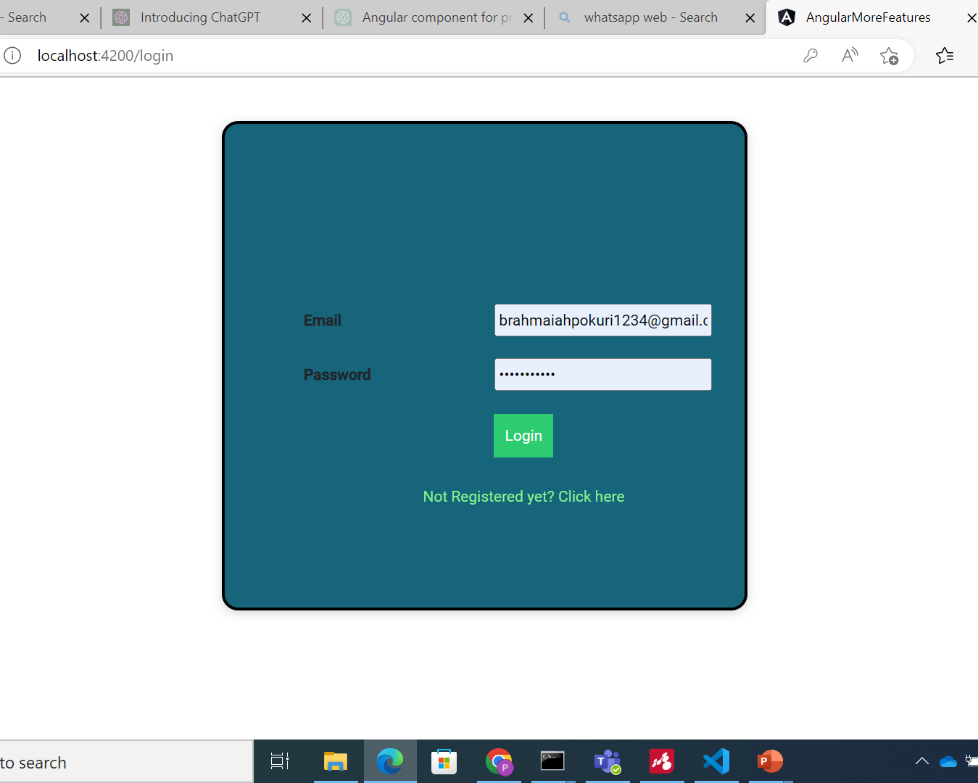
Login Page
User Login
Admin Login
User Registration
Admin Registration

Slide 4
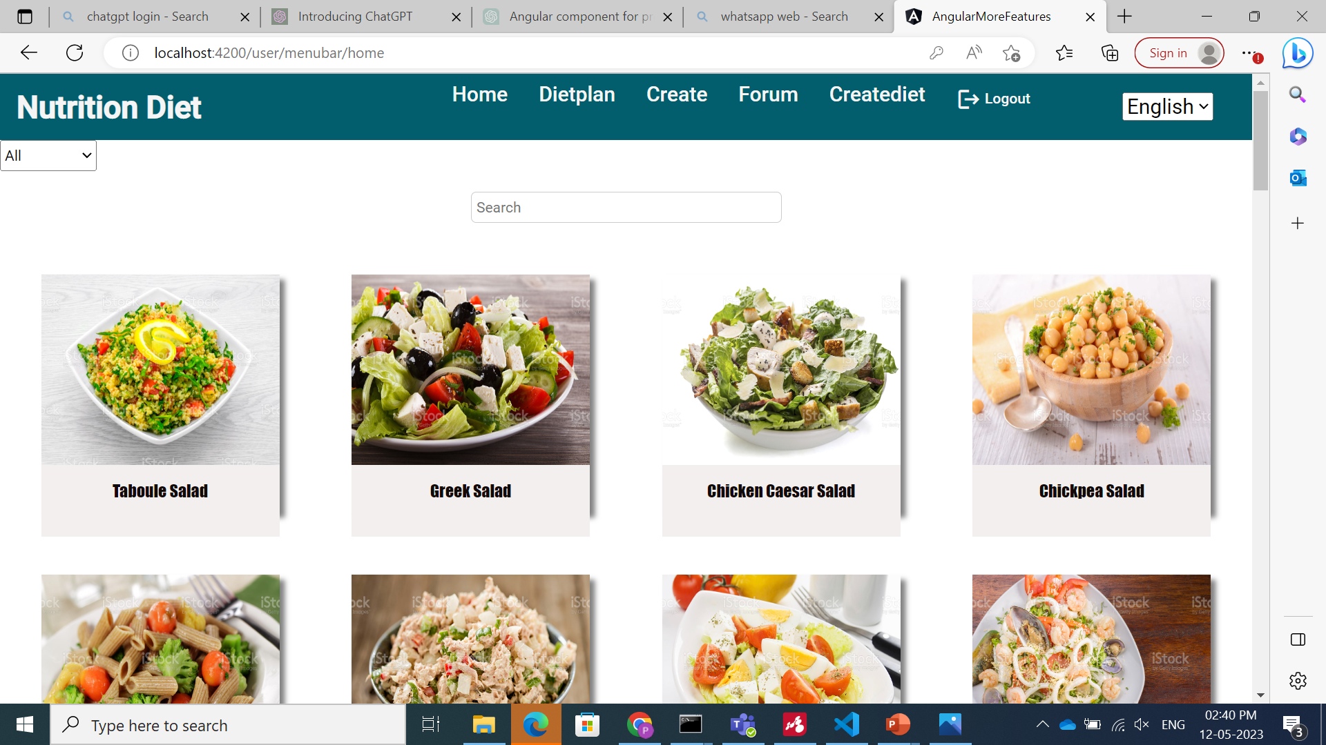
User – menu bar
Home
Diet Plan
Feedbacks
Create Diet
Forum
internationalization

Slide 5
User - home
In home all the Items
Like fruits, vegetables, juices,
and salads will be displayed
user can select the type of
Product and can search for
a particular item

Slide 6
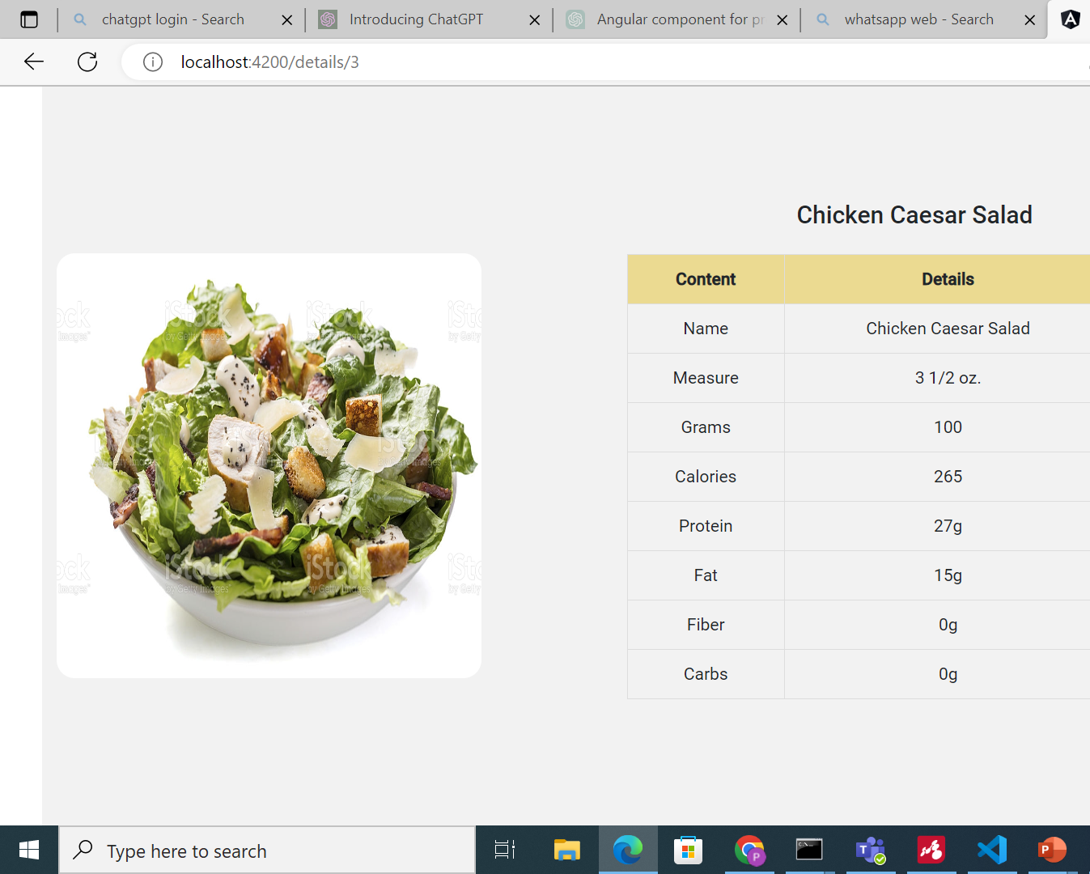
User – product Details
When you click on particular
Item user can view the nutritional
Values of the product.

Slide 7
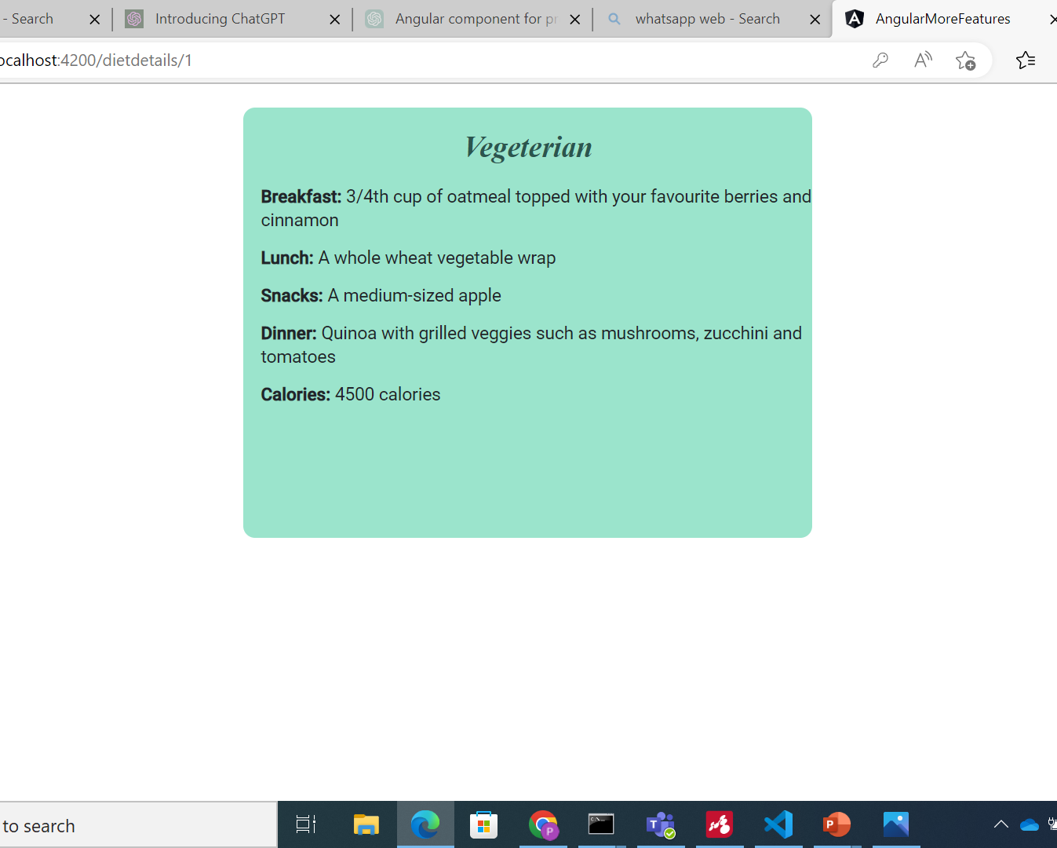
User-diet plan
User can view the different
types of diet plans and if click
on particular diet it will display
the menu for breakfast, lunch
and Dinner

Slide 8
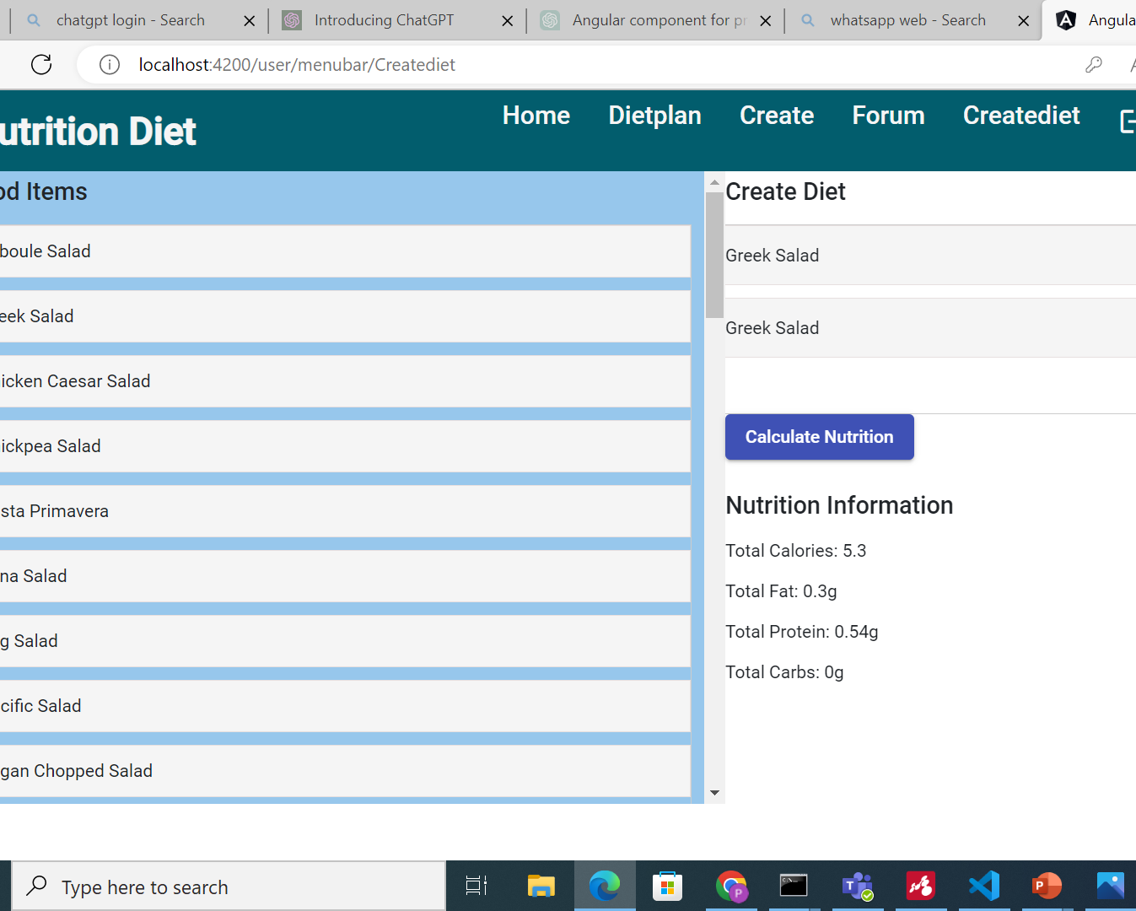
User-create diet
User can create their
Own diet plan by using
Drag and drop feature can
Also calculate the total nutritional
Values in the diet.

Slide 9
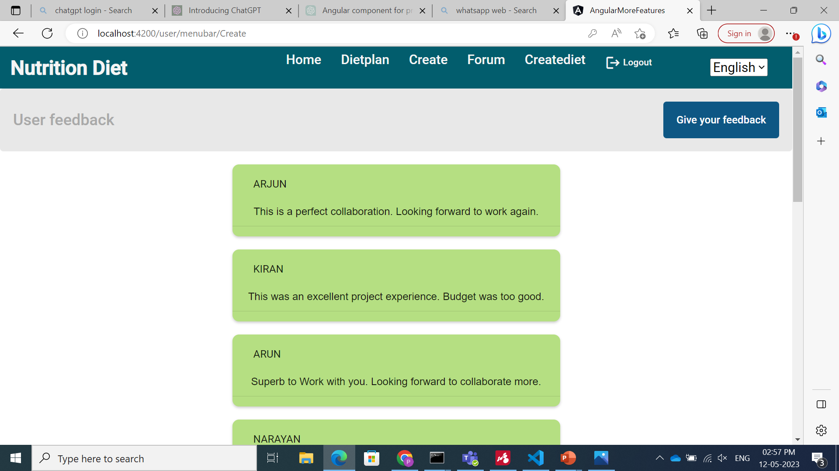
User - feedbacks
User can give feedback on
particular item and the diet plan
and can suggest on diet plan and
also on the nutrition diet.

Slide 10
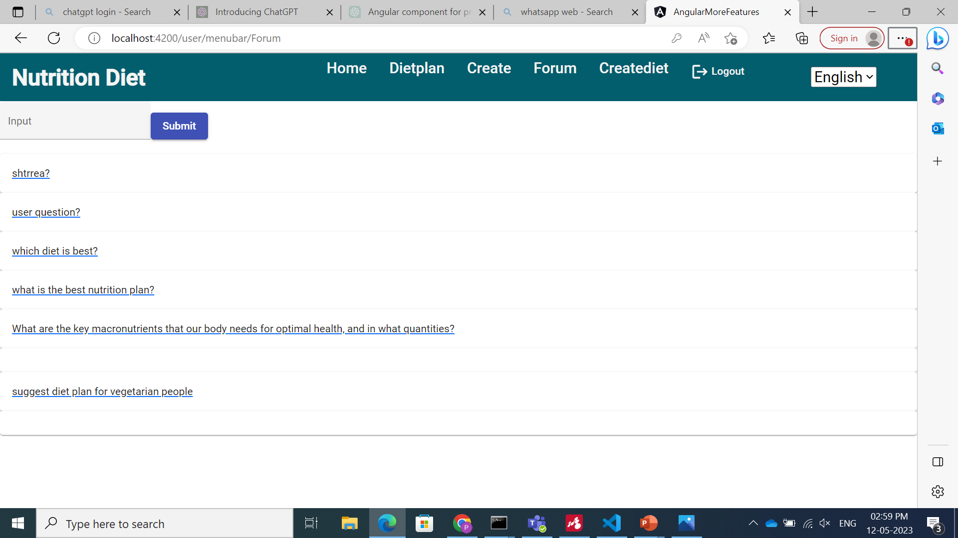
User - forum
If user has any queries regarding
diet plan and the food items can raise
query and he can view the response for
their queries admin will give responses.

Slide 11
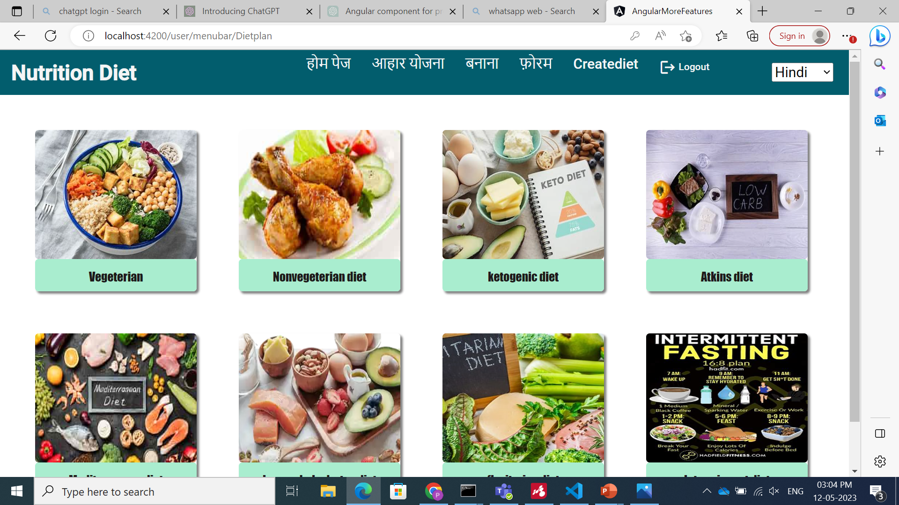
User – Internationalisation
If the user doesn’t knows
english user can select the languages
which are available in the selector
User can view in their own language

Slide 12
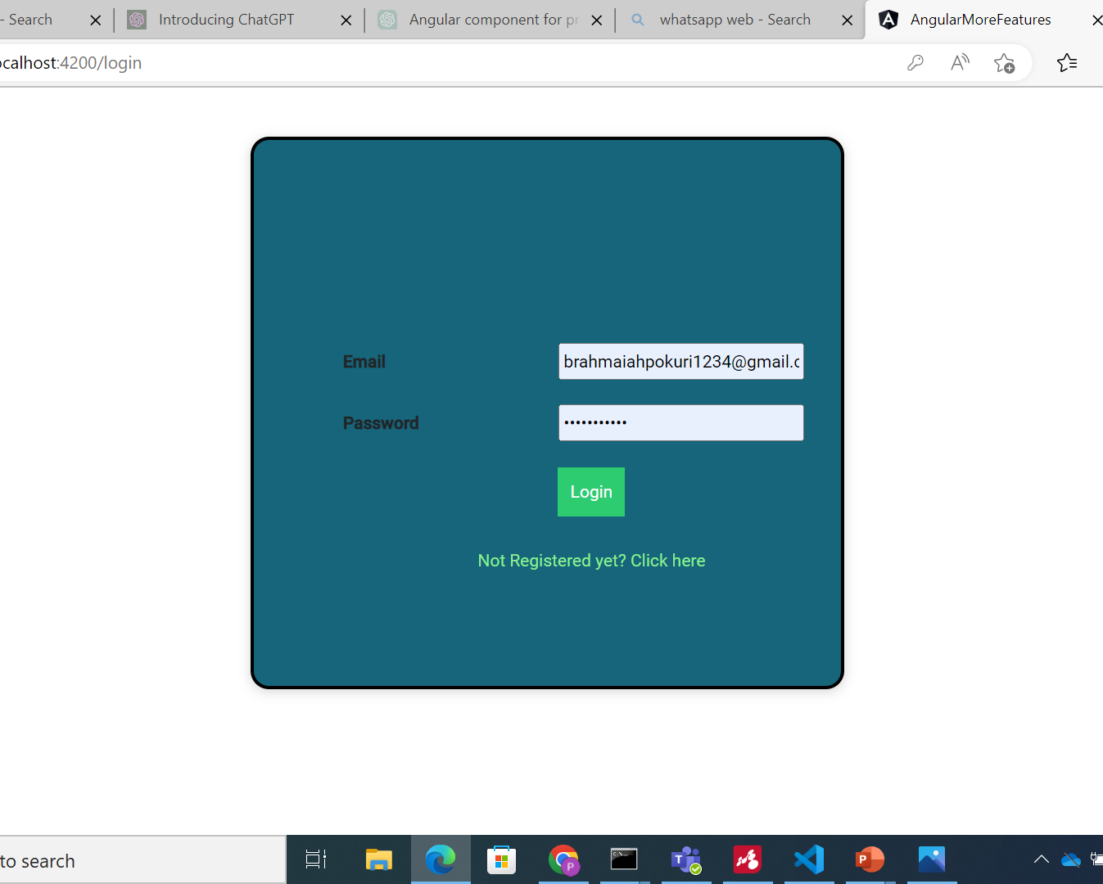
User-logout
User can simply logout
after completing their
Task.

Slide 13

Admin - login
Admin has to register with
User name and password then
Click on login button.

Slide 14
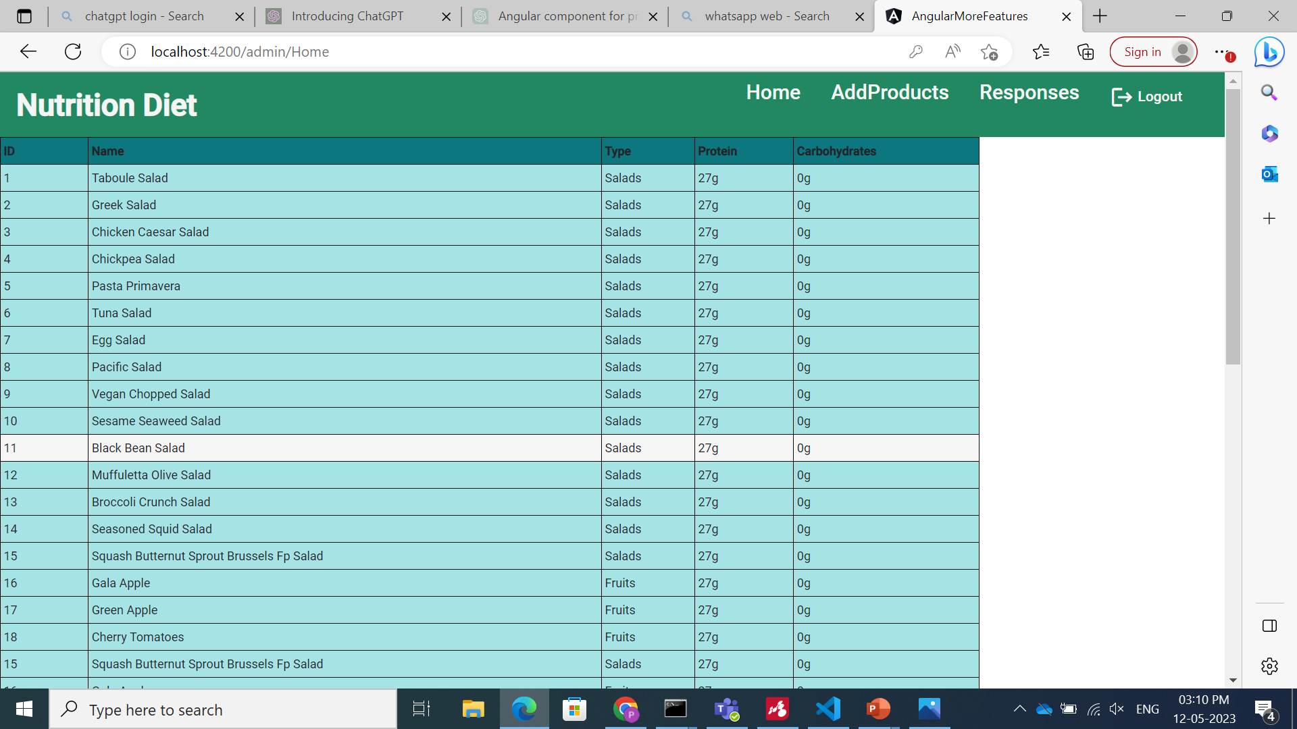
Admin-home
Displays a table that contains
Name and nutritional values of
The products which are added in
The home page of user home page

Slide 15
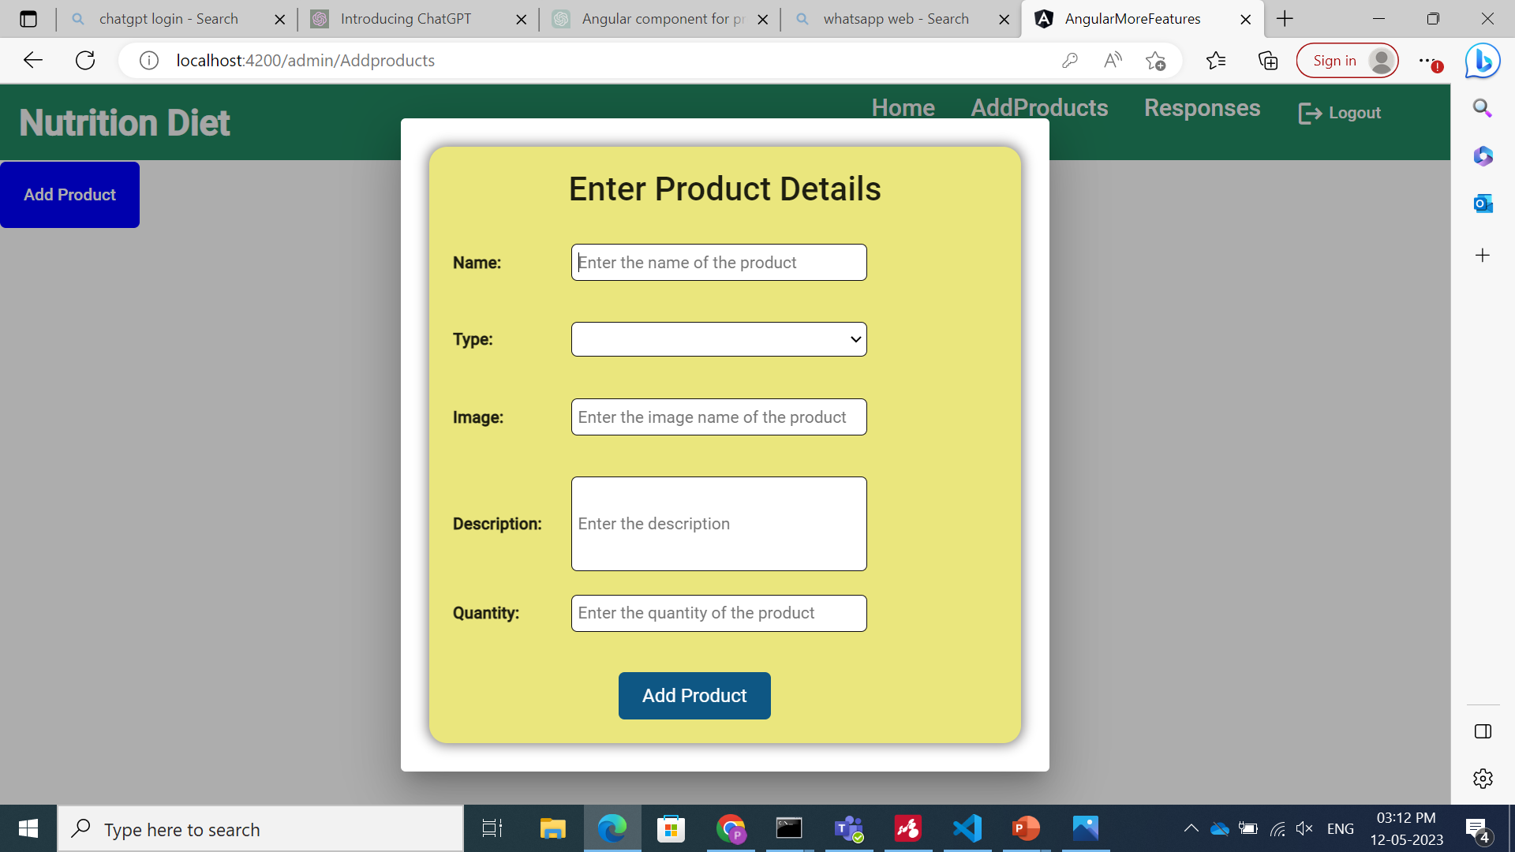
Admin-addproducts
Admin can add products
By clicking on add products button
And a form will be displayed where
Admin has to fill name, type and image file
Name and click on add product.

Slide 16
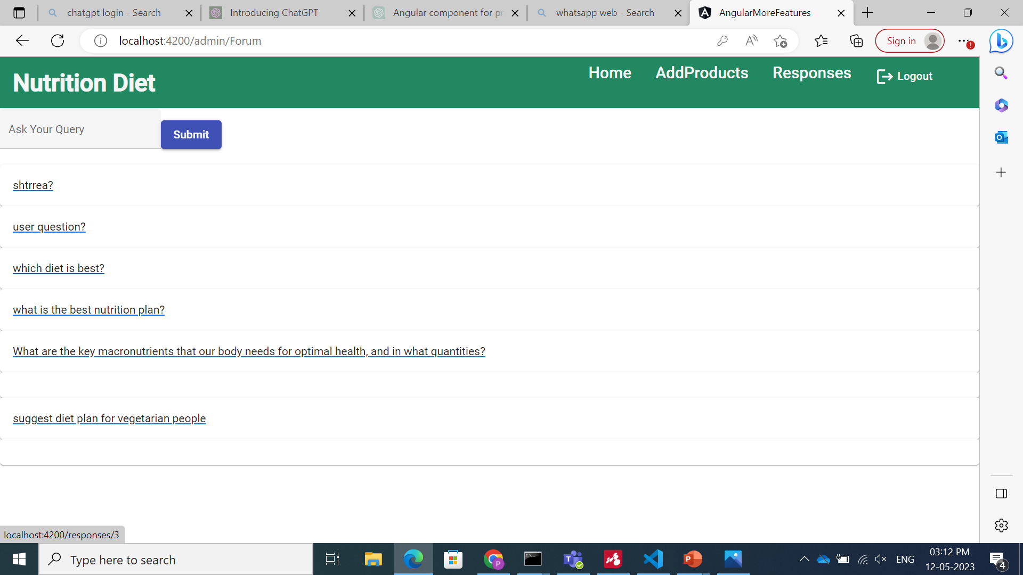
Admin-responses
Admin can view the
Queries asked in the user forum
And can reply to those queries.

Slide 17
concepts
Implemented Not Implemented
Used Component Hierarchy . Custom directives
Used services
Used pipes
For UI components, used angular material
Data maintained in Json-server API
Used Routing parameters
Implemented Lazy loading
Used both Template based & Model based approach
Implemented Multiple user flow
Internationalization
Complex feature implementation

Slide 18
Thank You

